Slide 1
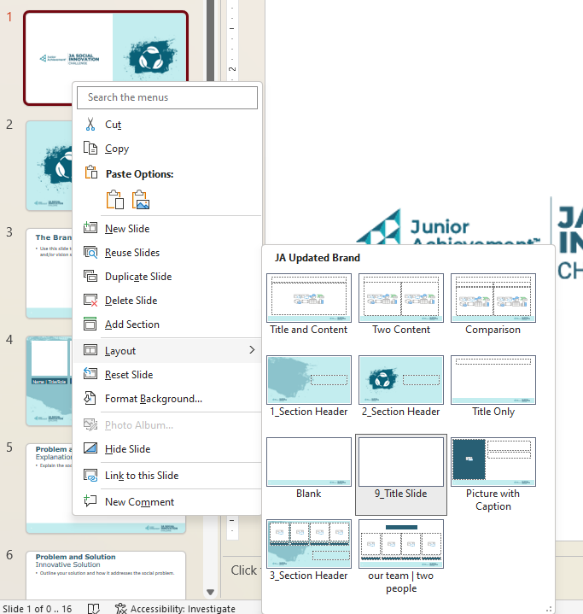

How to use this template:
Video Overview coming soon
“Save As” and change the name:
  Make it meaningful; include your team name in the document title.
Feel free to add text and images; change the layout and theme if you’d like! However, please do not add slides or re-arrange the order of the slides in the report. Judges will assess submissions based on the criteria within this report, so it should remain consistent.
To choose a different page layout right-click the page, and move your cursor to “Layout” to see all the available options.
Prior to submitting your report, save it as a PDF. Select File, Print, and then select “Microsoft Print to PDF” as your printer.
Judging Criteria
Guidelines Compliance
The report should adhere to guidelines noted in the JA Stock Market Challenge Guidelines and Competition Criteria. This includes avoiding spelling or grammatical errors, and attention to visual appearance.
Responses should not exceed the bounds of the slide, and there should be no text smaller than 12-point font.
Stock Selection
Review the detailed Stock List including descriptions and company history here, and use this spreadsheet to calculate your totals,
The report should include a selection of stocks and a distribution of assets that reflects an understanding of risk tolerance and portfolio diversification.
These selections will be used as the team’s starting portfolio should they be selected to compete in the national JA Stock Market Challenge.
Articulation of Strategy
The report should provide thoughtful and accurate articulation of the strategy behind the stock selections.
The strategy should reflect a clear understanding of the market, investing, and risk tolerance.
Decision Making
The report should reflect a clear understanding of how current events and the market impact each other and what this means for individual investors.
Organization and Collaboration
The report should showcase the team collaboration and delegation of duties. It should highlight the ways in which team members support each other throughout the competition and the contributions of all team members.
Learning Experiences and Future Application
The report should illustrate an understanding of the distinction between long-term investment strategy and the type of high-risk transactional trading that can sometimes offer short-term gains.
Notes:
Instructional video
“Get Creative”
Rubric

Slide 2
Team Name
School Name
JA Area
Team Members

Slide 3
Don’t forget…
These selections will be your starting portfolio during the national competition should your team be selected as finalists. Please review them carefully; modifications will not be accepted after submission.
Starting Portfolio
Symbol | Name | Industry | Starting Price | Shares | Total
ARCT | Arctic Foods, Limited | Frozen Foods | $ 17.76 | 0 | $0.00
BVC | Buffalo Valley Company | Mining/Metals | $ 10.00 | 0 | $0.00
CLBY | Colby Mack | Lifestyle (glasses/vision) | $ 21.34 | 0 | $0.00
CMF | Comfy Seats, Inc. | Furniture/Home Goods | $ 44.32 | 0 | $0.00
CURL | Curlart, Inc. | Consumer Products | $ 51.53 | 0 | $0.00
FCJ | Fourcees Jewelers | Luxury Goods | $ 102.16 | 0 | $0.00
GTRZ | Gators, Inc. | Shoes | $ 135.41 | 0 | $0.00
IMUL | Immuno Labs, Incorporated | Biotech | $ 2.90 | 0 | $0.00
JXL | Joux Limited | Tech | $ 99.43 | 0 | $0.00
LCKY | Lucky Brands, Incorporated | Home Products | $ 83.89 | 0 | $0.00
LHS | Lincoln Hammers & Screws | Tools and Hardware | $ 92.20 | 0 | $0.00
LNC | LNC Financial Services | Banking | $ 205.31 | 0 | $0.00
NME | Nomme, Incorporated | Chemicals | $ 82.80 | 0 | $0.00
PAIR | Pair, Incorporated | Tech | $ 32.70 | 0 | $0.00
RELY | Really Group, Inc. | Tech (real estate) | $ 74.18 | 0 | $0.00
RJI | Ruji Pictures | Entertainment | $ 17.48 | 0 | $0.00
SHFL | Shadyside Flooring | Flooring | $ 137.83 | 0 | $0.00
SPGR | Sparrow's Groceries | Food Markets | $ 19.64 | 0 | $0.00
SPTA | Sparta | Computer Software | $ 191.77 | 0 | $0.00
TOKN | Token Trade | Cryptocurrency | $ 251.09 | 0 | $0.00
UTL | Utley Services | Pest Control | $ 56.12 | 0 | $0.00
VTH | Veritas Health | Healthcare | $202.59 | 0 | $0.00
WDM | Walker-Dobbs Midwest | Commodities/Food Processing | $ 59.99 | 0 | $0.00
Total Stock Value: |  |  |  |  | $0.00
Starting Cash on Hand: |  |  |  |  | $1,000,000.00

Slide 4
Portfolio Selection Strategy
Share your team’s strategy for your stock selections. Please include an articulation of your risk tolerance and diversification strategy.
Your explanation cannot exceed the bounds of this text box, and it must be written in 12-point font or larger.

Slide 5
Decision Making: Scenario Response
Scenario Summary
A leading artificial intelligence company announces that a software flaw in its flagship AI assistant has caused widespread outages across hospitals, financial institutions, and schools. Early reports note potential safety concerns.
How the market events unfolded:
A: News leak of outages → AI Company's stock down 7% at market open.
B: AI Company confirms a global recall + earnings delay. Major competitor to this AI Company's stock jumps 10%.
C: Government announces possible AI regulatory review of all major providers.
Put yourselves in the shoes of a financial advisor.
How would your team adjust your client's investment strategy in response to this crisis? Include:
  Immediate reaction
  Short-term strategy
  Longer-term outlook
  Actions you would take to protect or reposition a portfolio
Use this space to share your recommendation for this investor.

Slide 6
Organization and Collaboration
Include:
Overview of team structure
Delegation of duties
How did you work as a team to compete in the JA Stock Market Challenge?
What did each member of the team do during the competition

Slide 7
Learning Experiences and Future Application
Share any successes, challenges, failures, or key learnings from the JA Take Stock in Your Future and JA Stock Market Challenge experience.
How will you utilize what you have learned to make financial decisions in the future?
Long-term investment strategy (real world)

Slide 8
Thank you/Wrap up
And one more thing… showcase any final thoughts not captured in the previous sections of your report.

