Slide 1
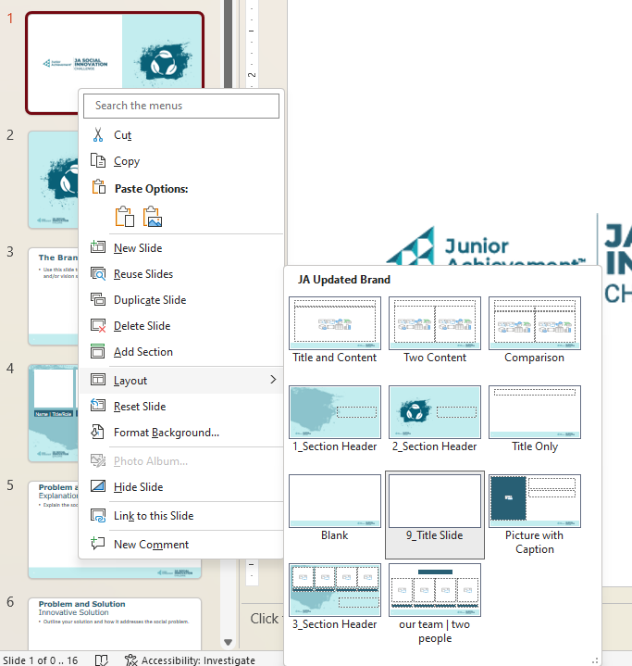

How to use this template:
Video Overview: https://data.ja.org/s/b2EAAA
“Save As” and change the name:
  Make it meaningful; include your team name in the document title.
Feel free to add text and images; change the layout and theme if you’d like! However, please do not add slides or re-arrange the order of the slides in the report. Judges will assess submissions based on the criteria within this report, so it should remain consistent.
To choose a different page layout right-click the page, and move your cursor to “Layout” to see all the available options.
Prior to submitting your report, save it as a PDF. Select File, Print, and then select “Microsoft Print to PDF” as your printer.
Judging Criteria
Guidelines Compliance
The report should adhere to guidelines noted in the JA Titan Challenge Guidelines and Competition Criteria. This includes avoiding spelling or grammatical errors, and attention to visual appearance.
Responses should not exceed the bounds of the slide, and there should be no text smaller than 12-point font.
Articulation of Strategy
The report should provide thoughtful and accurate articulation of the strategy behind department budget allocations and priorities.
The strategy should reflect a clear understanding of the relationship between businesses, the economy, and consumer choice.
Decision Making
The report should include a comprehensive and accurate analysis of the sample data.
The report should reflect a clear understanding of how the economy, competitors in the market, and consumer preference impact revenue. It should include well-reasoned guidance.
Organization and Collaboration
The report should showcase the team collaboration and delegation of duties. It should highlight the ways in which team members support each other throughout the competition and the contributions of all team members.
Learning Experiences and Future Application
The report should outline the relationship between the simulation and real-world business and economics. It should clearly articulate the ways in which competitors will utilize the skills gained through their participation in JA Titan.

Slide 2
Team Name
School Name
JA Area
Team Members

Slide 3
Strategy: R&D
What key decisions must you make in this section?
What information can you learn in the reports?
How do you determine how to prioritize features?
Strategy: Production
What key decisions must you make in this section?
What information can you learn in the reports?
How do you determine what price to set for your phones?

Slide 4
Strategy: Marketing & Sales
What key decisions must you make in this section?
What information can you learn in the reports?
How do you determine how many teams to distribute to work on different research tasks?
How do you prioritize advertising tasks?
Strategy: CSR
What key decisions must you make in this section?
What information can you learn in the reports?
How do you determine how much money to allocate to each CSR component?
Why is CSR important? How does it impact your company performance?

Slide 5
What would you do (what tabs would you review and what data would you look at) to determine how Twister Telecom began losing money and customers?
What would you advise Twister Telecom to do to improve their outcomes?

Slide 6
Organization and Collaboration
Include:
Overview of team structure
Delegation of duties
How did you work as a team to compete in the JA Titan Challenge?
What did each member of the team do during the competition

Slide 7
Learning Experiences and Future Application
What have you learned by participating in JA Titan? Share any successes, challenges, failures, or key learnings from your JA Titan experience.
How will you utilize what you have learned to make financial and career decisions in the future?
This section can include take-aways from your classroom learning and your competition experience if relevant.

Slide 8
Thank you/Wrap up
And one more thing… showcase any final thoughts not captured in the previous sections of your report.

