Slide 1
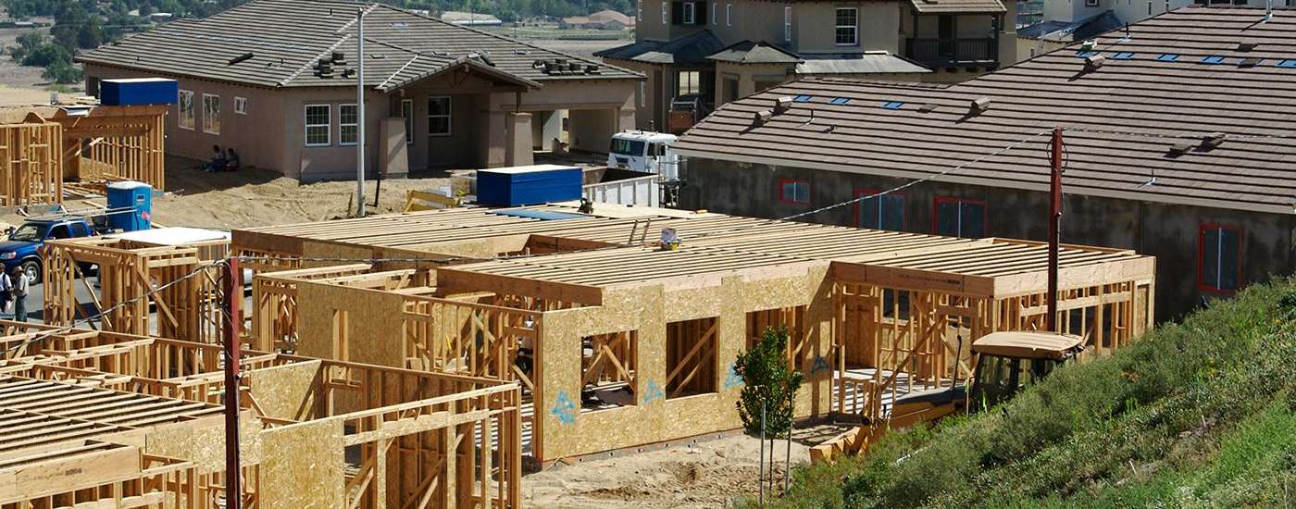
Making Important Life Decisions
CASE STUDY

Slide 2
What Goes into a Decision?
WARM-UP

Slide 3

Warm-Up | What Goes into a Decision?
What is a decision that you made lately?
Making Decisions

Slide 4
Warm-Up | What Goes into a Decision?
Hard Decisions
Consequences
The results or outcomes of a choice.

Slide 5
Decision Analysis
ACTIVITY ONE

Slide 6

Activity One | Decision Analysis
Essential Question
What strategies can we use to make the best decisions, given the information that we have?

Slide 7
Activity One | Decision Analysis
Decision Analysis
process
best solution
current circumstances
uncertainty

Slide 8



Activity One | Decision Analysis
Process for Making Decisions
Step 1
Step 2
Step 3
Define the
problem
Evaluate the
alternatives
Make the
decision

Slide 9
Using a Decision Tree
ACTIVITY TWO

Slide 10
Activity Two | Using a Decision Tree
Animal Careers
Read the scenario. Be ready to discuss the following:
What important life decision does Carmen face?
What key factors are important to Carmen?
What uncertainties does Carmen face?

Slide 11
Activity Two | Using a Decision Tree
Decision Tree
Decision tree
A tool that can help in decision making.
A decision tree should:
state the decision
identify the choices
identify the potential consequences of the choices
identify uncertainty

Slide 12
Activity Two | Using a Decision Tree
What Is a Decision Tree?
The Decision Question
Uncertainty
No
Yes
Key Factor
Key Factor
Key Factor
Key Factor
Key Factor
Key Factor
Key Factor
Key Factor
decision
uncertainty

Slide 13
Activity Two | Using a Decision Tree
Carmen Decision Tree
Become a veterinarian?
Cost and Time
No
Yes
4-6 years of training
work with animals
High cost of education
interesting & varied work settings
long periods of time studying
highest salary of the 3 options
other?
other?
decision
uncertainty

Slide 14
Animal Careers
ACTIVITY THREE

Slide 15
Activity Three | Managing Risk and Crisis
Carmen’s Results
What decision-making processes, tools, information, and strategies helped Carmen make her decision?
What key factors are important to you in making your own career decisions?
What lessons will you take away from this experience?

Slide 16
Decisions and Risks
WRAP-UP

Slide 17
Wrap-Up
Key Points
What is decision-making?
How does a decision tree work?
What decision-making processes, tools, and strategies helped Carmen make her decision?
How can you determine good source of information?

